Slide 1
Design Principles Interfaces
An interface defines what services the software unit provides to the rest of the system, and how other units can access those services
For example, the interface to an object is the collection of the object’s public operations and the operations’ signatures, which specify each operation’s name, parameters, and possible return values
An interface must also define what the unit requires, in terms of services or assumptions, for it to work correctly
A software unit’s interface describes what the unit requires of its environment, as well as what it provides to its environment

Slide 2
6.2 Design Principles Interfaces (continued)
A software unit may have several interfaces that make different demands on its environment or that offer different levels of service
Module
Data
________________
_________________
_________________
Operation 1
_________________
_________________
_________________
_________________
Operation 2
_________________
_________________
_________________
_________________
Interface A
Operation 1 ()
Operation 2 ()
Operation 4 ()
Operation 3
_________________
_________________
_________________
_________________
Operation 4
_________________
_________________
_________________
_________________
Interface B
Operation 2 ()
Operation 3 ()

Slide 3
Design Principles Interfaces (continued)
The specification of a software unit’s interface describes the externally visible properties of the software unit
An interface specification should communicate to other system developers everything that they need to know to use our software unit correctly
Purpose
Preconditions (assumptions)
Protocols
Postconditions (visible effects)
Quality attributes

Slide 4
Design Principles Information Hiding
Information hiding is distinguished by its guidance for decomposing a system:
Each software unit encapsulates a separate design decision that could be changed in the future
Then the interfaces and interface specifications are used to describe each software unit in terms of its externally visible properties
Using this principle, modules may exhibit different kinds of cohesion
A module that hides a data representation may be informationally cohesive
A module that hides an algorithm may be functionally cohesive
A big advantage of information hiding is that the resulting software units are loosely coupled

Slide 5
Design Principles :Incremental Development
Given a design consisting of software units and their interfaces, we can use the information about the units’ dependencies to devise an incremental schedule of development
Start by mapping out the units
relates each software unit to the other software units on which it depends
Graphs can help to identify progressively larger subsets of our system that we can implement and test incrementally

Slide 6
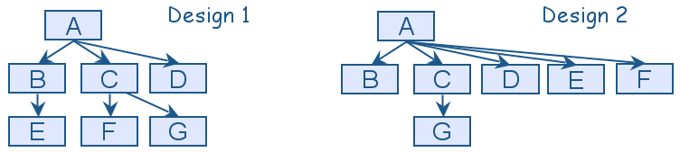
Design Principles Incremental Development (continued)
Uses graphs for two designs
Fan-in refers to the number of units that use a particular software unit
Fan-out refers to the number of units used by particular software unit
Fan-in is a measure of the number of functions or methods that call some other function or method (say X). Fan-out is the number of functions that are called by function X.

Slide 7
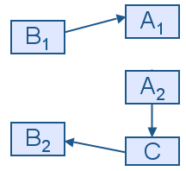
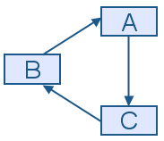
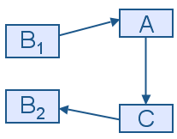
Design Principles Incremental Development (continued)
One of the cycle’s units is decomposed into two units, such that one of the new units has no dependencies
Sandwiching can be applied more than once, to break either mutual dependencies in tightly coupled units or long dependency chains
(a)
(b)
(c)

Slide 8
Design Principles Abstraction
An abstraction is a model or representation that omits some details so that it can focus on other details
The definition is vague about which details are left out of a model, because different abstractions, built for different purposes, omit different kinds of details

Slide 9
Design Principles Ex. Abstraction
Suppose that one of the system functions is to sort the elements of a list L. The initial description of the design is:
Sort L in nondecreasing order
The next level of abstraction may be a particular algorithm:
DO WHILE I is between 1 and (length of L)–1:
Set LOW to index of smallest value in L(I),..., L(length of L)
Interchange L(I) and L(LOW)
ENDDO
The algorithm provides a great deal of additional information, however, it can be made even more detailed

Slide 10
Design Principles Using Abstraction (continued)
The third and final algorithm describes exactly how the sorting operation will work:
DO WHILE I is between 1 and (length of L)-1
Set LOW to current value of I
DO WHILE J is between I+1 and (length of L)
IF L(LOW) is greater than L(J)
THEN set LOW to current value of J
ENDIF
ENDDO
Set TEMP to L(LOW)
Set L(LOW) to L(I)
Set L(I) to TEMP
ENDDO

Slide 11
Design Principles :Generality
Generality is the design principle that makes a software unit as universally applicable as possible, to increase the chance that it will be useful in some future system
We make a unit more general by increasing the number of contexts in which can it be used. There are several ways of doing this:
Parameterizing context-specific information
Removing preconditions
Simplifying postconditions

Slide 12
Design Principles Generality (continued)
The following four procedure interfaces are listed in order of increasing generality:
PROCEDURE SUM: INTEGER;
POSTCONDITION: returns sum of 3 global variables
PROCEDURE SUM (a, b, c: INTEGER): INTEGER;
POSTCONDITION: returns sum of parameters
PROCEDURE SUM (a[]: INTEGER; len: INTEGER): INTEGER
PRECONDITION: 0 <= len <= size of array a
POSTCONDITION: returns sum of elements 1..len in array a
PROCEDURE SUM (a[]: INTEGER): INTEGER
POSTCONDITION: returns sum of elements in array a

Slide 13
Design Strategies
Functional design
The system is designed from a functional viewpoint.
The system state is centralized and shared between the functions operating on that state.
Object-oriented design
The system is viewed as a collection of interacting objects.
The system state is decentralized and each object manages its own state.
Objects may be instances of an object class and communicate by exchanging methods.

Slide 14
Mixed-strategy Design
Although it is sometimes suggested that one approach to design is superior, in practice, an object-oriented and a functional-oriented approach to design are complementary.
Good software engineers should select the most appropriate approach for whatever sub-system is being designed.

Slide 15
Design Quality
Design quality is an elusive concept. Quality depends on specific organizational priorities.
A “good” design may be the most efficient, the cheapest, the most maintainable, the most reliable, etc.
The attributes discussed here are concerned with the maintainability of the design.
Quality characteristics are equally applicable to function-oriented and object-oriented designs.

Slide 16
Attribute: Cohesion
A measure of how well a component “fits together”.
A component should implement a single logical entity or function.
Cohesion is a desirable design component attribute as when a change has to be made, it is localized in a single cohesive component.
Various levels of cohesion have been identified.

Slide 17
Cohesion Levels
Coincidental cohesion (weak)
Parts of a component are simply bundled together.
Logical association (weak)
Components which perform similar functions are grouped.
Temporal cohesion (weak)
Components which are activated at the same time are grouped.

Slide 18
Cohesion Levels
Communicational cohesion (medium)
All the elements of a component operate on the same input or produce the same output.
Sequential cohesion (medium)
The output for one part of a component is the input to another part.
Functional cohesion (strong)
Each part of a component is necessary for the execution of a single function.
Object cohesion (strong)
Each operation provides functionality which allows object attributes to be modified or inspected.

Slide 19
Cohesion vs coupling
Cohesion
A measure of how well a component “fits together”
Coupling
A measure of the strength of the inter-connections between system components.

Slide 20
Coupling and Inheritance
Object-oriented systems are loosely coupled because there is no shared state and objects communicate using message passing.
However, an object class is coupled to its super-classes. Changes made to the attributes or operations in a super-class propagate to all sub-classes.

Slide 21
Attribute: Understandability
Related to several component characteristics
Can the component be understood on its own?
Are meaningful names used?
Is the design well-documented?
Are complex algorithms used?
Informally, high complexity means many relationships between different parts of the design.
32

Slide 22
Attribute: Adaptability
A design is adaptable if:
Its components are loosely coupled.
It is well-documented and the documentation is up to date.
There is an obvious correspondence between design levels (design visibility).
Each component is a self-contained entity (tightly cohesive).
To adapt a design, it must be possible to trace the links between design components so that change consequences can be analyzed.
33

Slide 23
Design Traceability

Slide 24
Adaptability and Inheritance
Inheritance dramatically improves adaptability. Components may be adapted without change by deriving a sub-class and modifying that derived class.
However, as the depth of the inheritance hierarchy increases, it becomes increasingly complex. It must be periodically reviewed and restructured.
35

